Slide 1
Twitter Overspending A/B testing
Twitter A/B Testing: Ad Billing Model Experiment
Presented by: Vikas Upadhyay
Date: 02/07/2025

Slide 2
Agenda
Problem Statement
Project Overview
Key Insights
Recommendations
Conclusion

Slide 3
Problem Statement
How can Twitter effectively reduce overspending in ad campaigns, given the delay in click reporting that leads to exceeding advertiser budgets? Is the new ad product, which charges advertisers per impression instead of per click, successful in minimizing overspending compared to the existing click-based model, as demonstrated by the recent A/B test results.

Slide 4
Project Overview
Twitter offers advertising via a click-based billing model.
Problem: Delay between clicks and billing → overspending beyond advertiser budgets.
Solution Tested: New impression-based billing model to reduce billing latency.
Method: A/B Test:
Control Group: Click-based billing
Treatment Group: Impression-based billing

Slide 5
Descriptive Statistics
Average Overspend: 21.46%
Typical Campaigns: Spend slightly over budget (~5.62% median).
High Variability: Significant spread across campaigns.
Outliers: Some campaigns overspent by up to 400%.
Lower Bound: some campaigns underspent their budget by up to -57.49%.

Slide 6
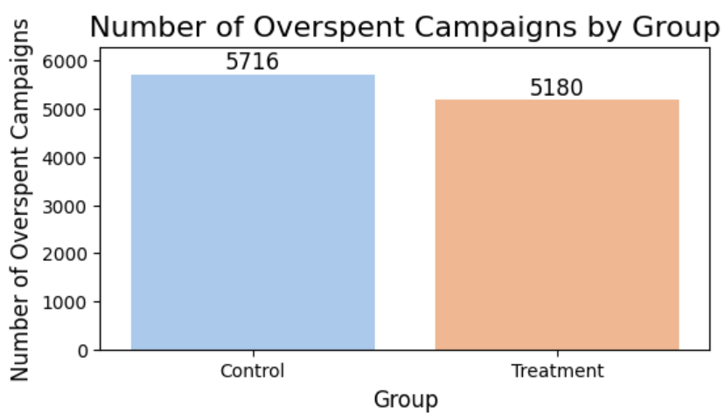
Campaign Overspending Count
Control Group: 5,716 campaigns overspent (>1% of budget)
Treatment Group: 5,180 campaigns overspent
Insight: Overspending is lower in the treatment group.

Slide 7
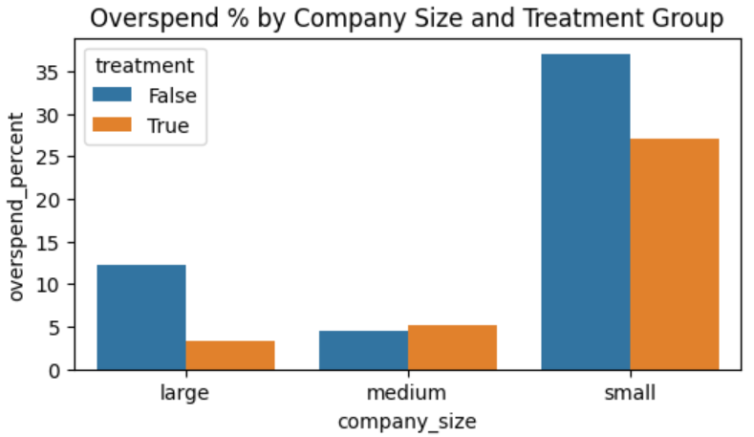

Overspend Reduction by Company Size
The new model is most effective for large and small companies.
Medium-sized companies show minimal change.
There is a statistically significant difference in overspend percentages between the control and treatment groups.

Slide 8
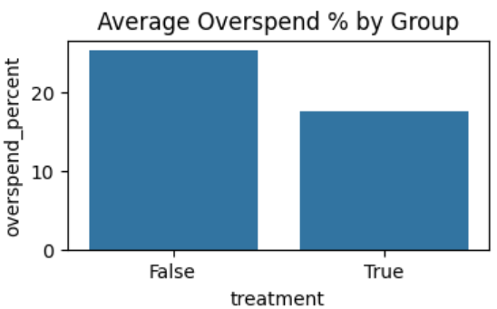
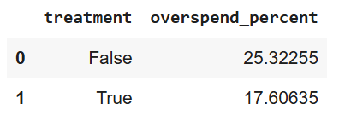
Overspend Percentage Comparison
The treatment group (impression-based model) has a lower average overspend compared to the control group.
Overspending reduced by ~7.71 percentage points.
The new billing model is effective in reducing overspending.

Slide 9
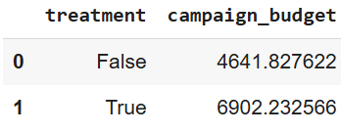
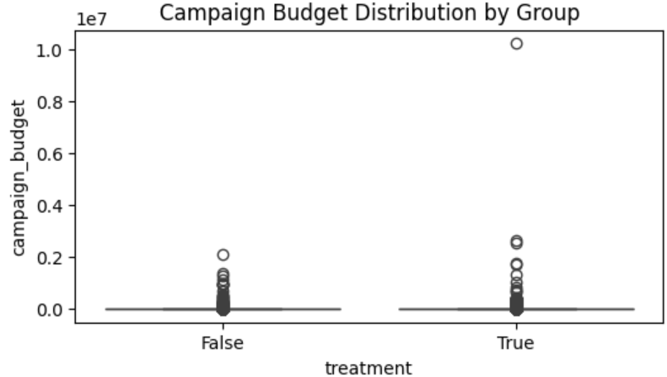

Budget Entry Behaviour
Control Avg. Budget: 4,641.83
Treatment Avg. Budget: 6,902.23
Conclusion: No significant difference in budgets - No evidence that advertisers are lowering budgets.

Slide 10
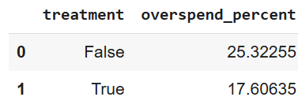

Average Overspend Percentages
Control Group: 25.32%
Treatment Group: 17.60%
Statistically significant reduction in overspending.

Slide 11
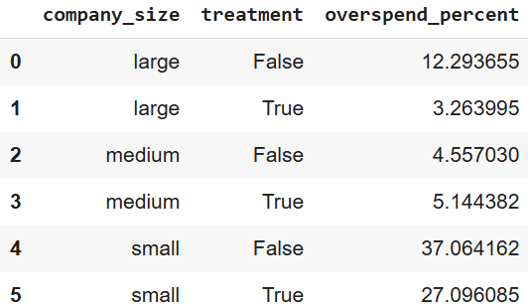
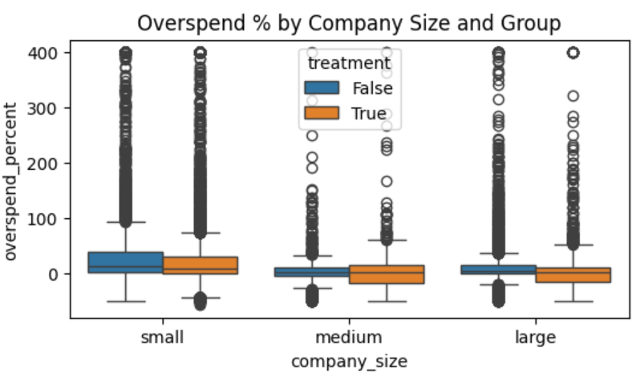
Overspend Patterns by Company Size and Group
Large companies benefit most from the new billing model.
Small companies consistently overspend the most, but the treatment reduces their overspend.
Medium companies show minimal difference between control and treatment groups.

Slide 12
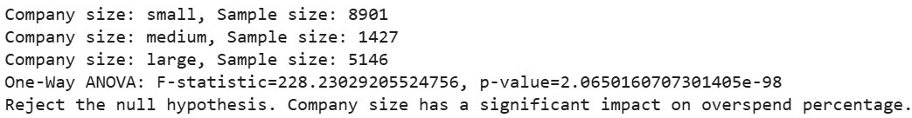
Demographic Factors (Company Size)
One-Way ANOVA Result:
F-statistic: 228.23
P-value: 2.07e-98
Conclusion: Company size significantly impacts overspending.
Small companies consistently overspend the most.

Slide 13

Variance Comparison
Variance (Control): 5,456.99
Variance (Treatment): 4,876.91
F-statistic: 1.12
Conclusion: No significant difference in variance → Similar spending variability across groups.

Slide 14
Association Between Treatment and Overspending
Chi-Square Statistic: 90.67
P-Value: 1.70e-21
There is a statistically significant association between the billing model (treatment/control) and overspending status.
Overspending depends on the billing model used.
Treatment group (impression-based model) is less likely to overspend.

Slide 15
Recommendation
Rollout the Impression-Based Model broadly.
Focus marketing on budget control benefits.
Provide additional budget management tools for small advertisers.
Monitor CTR, engagement, and advertiser satisfaction post-rollout.
Segment support and education based on company size.

Slide 16
Conclusion
New billing model significantly reduces overspending.
Effective across all company sizes, especially large and small.
No evidence that advertisers are entering lower budgets in the treatment group.
Variability in spending remains consistent.
Company size significantly influences overspending patterns.

Slide 17

The End

